Slide 1
Mockingjay: Approximating Belady’s OPT Cache Replacement Algorithm
Mahmoud Abumandour
Marzieh Barkhordar

Slide 2
Summary
Problem?
Cache replacement is an important and well-studied problem
Belady’s OPT policy is not realizable in hardware as it needs to foresee the future

Slide 3
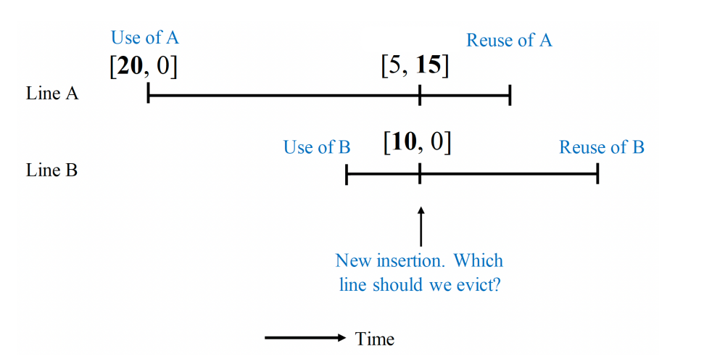
Summary
Prior Works?
Binary-Classification-Based Policies
A small prediction error will flip a prediction from one class to the other
Fail to evict the optimal block due to the coarse-grained prediction
Reuse-Distance Prediction Policies → using a combination of a line’s predicted ETA (Estimated Time of Arrival) and the line’s age in the cache
Mostly use an age-based LRU ordering in their decision
Their predicted ETA values are often incorrect due to the low accuracy of their reuse distance predictions
Notes:
For example, KPK use max of ETA and line’s age to make decision about eviction, as you can see in this picture, A will be reused earlier than B, so at the point where a new line is inserted, line B should evicted, but KPK would instead evict A.

Slide 4
Summary
Goal?
Using Mockingjay policy to approximate Belady’s policy more accurately but replaces Belady’s knowledge of future reuse times with predicted reuse times

Slide 5
Key Ideas
Using a long history of the past
Enabling Mockingjay to perform accurate reuse distance prediction
Performing multiclass prediction
More resilient to prediction errors than binary prediction
Having priorities on the relative order of predicted reuse times
Inoculating Mockingjay against prediction errors that are too small to change the relative order of reuse times
Inferring priorities at the time of eviction
Providing additional information
Notes:
It make more sense to inferring priorities at the time of eviction when reuse information
about other lines is available, whereas previous solutions
based on binary prediction assign priorities at the time of
insertion.

Slide 6
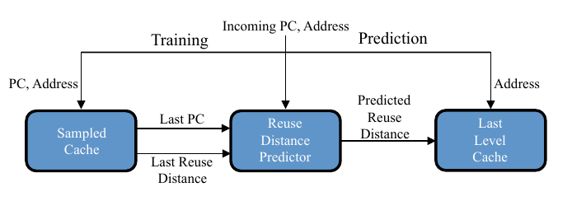
Overview of the Mechanism
Notes:
The mechanism is that, we use a sample cache to train a reuse distance predictor, and we use this predictor to provide predicted ETA value for each line of the cache. So, mockingjay policy can use these predicted ETA values to make decision which line should be evicted. We will explain these component in detail in the next slides.

Slide 7
Key Components: Sampled Cache
Goal: track past reuse distances to train the RDP
Maintaining a long history of past cache accesses for a few sampled cache sets
Organization: a set-associative cache and is indexed using the cache line address. Contains address tag, last access timestamp, and signature of the PC generating the access.
When the RDP can’t make an informed decision, it can evict the LRU block
Notes:
The goal of the Sampled Cache is to track past reuse distances to train the RDP, which predicts future reuse distances.
To track reuse distances, the Sampled Cache maintains a long history of past cache accesses for a few sampled cache sets. The Sampled Cache is organized as a set-associative cache and is indexed using the cache line address.
Each entry in the Sampled Cache maps block addresses to their last access timestamp and their last PC signature. Since it’s only used for storing the history of estimated arrival times, it doesn’t contain the data of the blocks, only the tags.

Slide 8
Key Components: Reuse Distance Predictor (RDP)
Goal: learns reuse distances for loads initiated by a given program counter
Organization: a direct-mapped cache and is indexed by a PC signature (a portion of PC with a concatenated bit representing a hit/miss access)
Uses temporal difference learning to eliminate anomaly value
Notes:
The RDP is a PC based predictor that learns reuse distances for loads initiated by a given program counter (PC).
It’s organized as a direct-mapped cache and is indexed by a PC signature.
Mockingjay uses separate predictor entries—and therefore learns separate reuse distances—for loads by a PC that hit in the cache and for loads by that same PC that miss in the cache. A bit is concatenated to PC that indicates whether an access was a hit or a miss, and then the PC is hashed.
More entries makes less entries map to the same slot. The paper uses 2048 entries (11 bits of the hashed PC), and so do us in our implementation.
Temporal difference learning updates predicted values as a linear function of the difference between the predicted and observed values. Thus, to limit the effect of outliers, the counter update is biased to maintain the old value but is still influenced by the new reuse distance. If the new reuse distance is significantly larger than previous one, it only adds 1/16 of the difference between the two reuse distances.

Slide 9
Key Components: ETA Counters
The cache itself maintains the Estimated Time for Arrival (ETA) for each block
On insertion, a line’s predicted reuse distance is stored in the cache as ETA.
On inserting a block that’s predicted to be reused further than all blocks in cache, the block is not inserted.
Notes:
Finally, the cache itself maintains the ETA for each line.
On inserting a new block, the block’s predicted reuse distance is used as the ETA for that block. The ETA values are used to make eviction decisions for future cache misses.
Cache insertions that are predicted to have ETA values larger than any existing line in the set are bypassed, which means that they are not inserted in the cache. Mockingjay produces an ETA prediction on both cache hits and misses.

Slide 10
Methodology
Simulator: gem5
Benchmarks: SPECCPU2017
Baseline Replacement Policies: LRU, SHiPMem, SHiPPC, BRRIP
Configuration:
L1 I-Cache | 32 KB, 8-way
L1 D-Cache | 32 KB, 8-way
L2 Cache | 1 MB, 16-way
No of fast-forward instructions | 100000000
No of warm-up instructions | 100000000
No of stats collecting instructions | 100000000

Slide 11
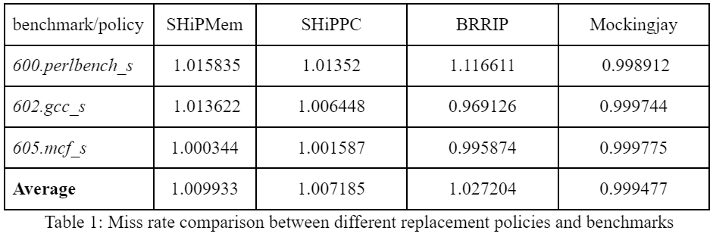
Key Results: Miss Rate (Normalized to LRU rate)

Slide 12
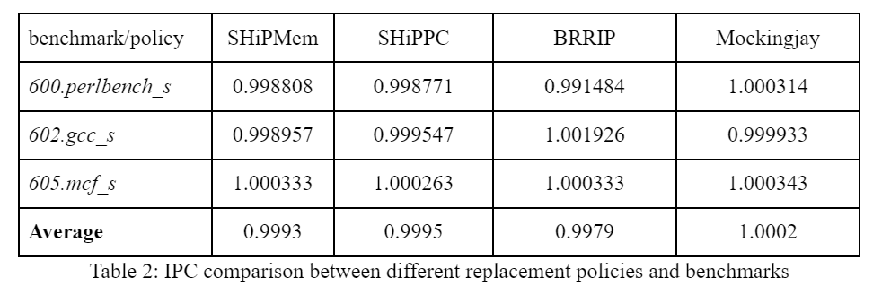
Key Results: IPC (Normalized to LRU rate)

Slide 13
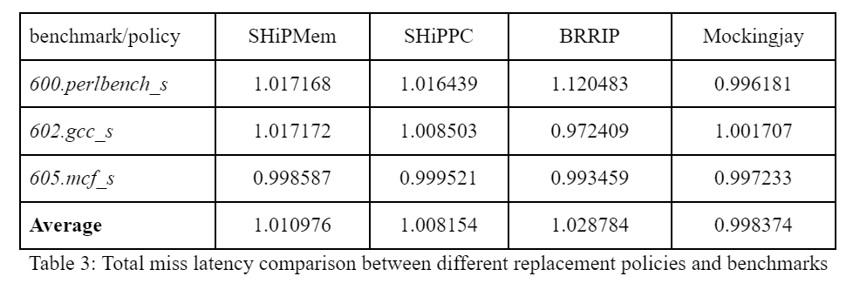
Key Results: Total Miss Latency (Normalized to LRU rate)

Slide 14
Conclusion
Multi-class prediction allows fine grained approximation of Belady’s policy
Mockingjay outperforms other policies on average (and in most individual cases) in all three metrics
Training the RDP requires warming up the simulator for a substantial amount of instructions to obtain significant improvements over other policies
Notes:
Mockingjay approximates the “stated goal” of Belady’s policy by evicting lines predicted to be reused furthest in the future

Slide 15
Thank you

